Slide 1
Deep Learning Based Portfolio Management System
JITENDRA JAIN Jai
55326734

Slide 2
TABLE OF CONTENTS
01
02
03
Introduction & Background
System Design & Methodology
Evaluation and Results
04
05
06
Reflection and Future Work
Conclusion
References

Slide 3

"How many millionaires do you know who have become wealthy by investing in savings accounts? I rest my case."
—Robert G. Allen
ZERO!

Slide 4
01 Introduction & Background

Slide 5
What is a Portfolio?
A portfolio is a collection of financial investments, such as:
Bonds
Stocks
ETFs
Cash

Slide 6

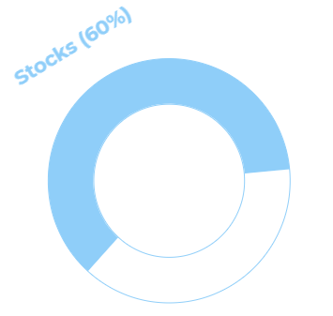
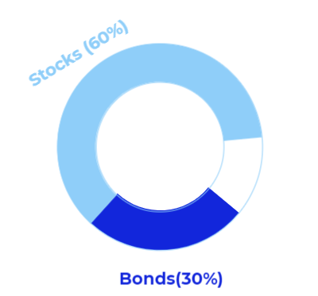
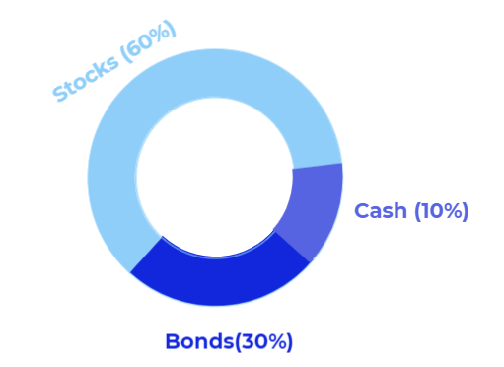


400,000 USD
100,000 USD
1,000,000 USD
0 USD

Slide 7
What is Portfolio Management?
Altering the composition of your portfolio by changing the proportion of stocks, bonds etc. according to market conditions.
Factors to Consider:
Income
Target return
Age
Ability to undertake risks

Slide 8
Stock Indicators
Technical Indicators
Fundamental Indicators
Relative Strength Index (RSI)
Moving Average Convergence/Divergence (MACD)
On-Balance Volume (OBV)
Accumulation/Distribution Line (A/D Line)
…..
Earnings Per Share (EPS)
Price-to-Earnings Ratio (PE Ratio)
Price-to-Book Ratio (PB Ratio)
Return on Equity (ROE)
…..

Slide 9

Problem Statement & Project Motivation
Problem Statement
Project Motivation
High management fees charged by asset management institutions
Depreciation of wealth in savings account due to negative interest rates
Complexity of financial data and lack of expertise to conduct technical analysis
To provide an affordable portfolio management service
To encourage individuals to enter the financial market by removing knowledge barriers
To create passive income and beat inflation by investing in the stock market

Slide 10
Alternative Solution 1: Statistical Models
Previously, researchers have implemented models such as ARIMA for financial time series forecasting.
Strengths:
Works well with stationary data
Requires less computational power and easy to build
Limitations:
Unable to adapt to the fluctuations in the momentum of the stock
Severely dependent on the stationary nature of the data

Slide 11
Alternative Solution 2: Machine Learning Models
Recently, machine learning models such as Genetic Algorithms and Support Vector Machine (SVM) are being used for Time Series forecasting.
Strengths:
Unlike traditional statistical models, ML models are able to process high volume data in a shorter period of time
Able to process multi-dimensional data
Limitations:
Require constant human intervention and parameter tuning
Unable to identify relevant features and adapt to the changes in the behaviour of the stock

Slide 12
Approach to resolving previous limitations
In all previous solutions, there is an absence of customization while predicting a specific stock. All solutions used the same set of features and hyperparameters for all stocks and did not recognize the unique behaviour of each stock.
This project attempts to provide a customized solution for each stock. For each stock, this project implemented the following steps:
Identify the relevant features with respect to the time period of the dataset.
Adjust the hyperparameters according to the unique characteristics of the stock.
Incorporate sentiment analysis to predict a random bullish or bearish price swing, which cannot be supported or explained by technical analysis.

Slide 13
02 System Design & Methodology

Slide 14
Overview of system design
Data Preprocessing
Recursive Feature
Elimination
Principal Component Analysis
Raw Data
Predicted Results
Hyperparameter Tuning
Train LSTM
Processed Data
Portfolio Building and Optimization
Sentiment Analysis

Slide 15
Recursive Feature Elimination
Recursive Feature Elimination (RFE) is used to identify the most important and informative features in the multi-dimensional stock data. Using cross-validation technique, the algorithm applies the dataset to a regression model, and in each iteration drops a configurable number of features. The features that are assigned the lowest weights by the regression model are dropped.
RFE Process
EMA 3
EMA 3
HIGH
RSI
HIGH
SMA 3
LOW

Slide 16

Long Short Term Memory Model

Slide 17
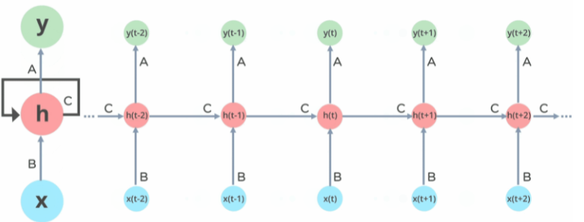
Long Short Term Memory Model

Slide 18
Train LSTM with Hyperparameter Tuning
After feature processing, the final dataset is fed to the LSTM model. The model uses the data from the past 21 days (21 datapoints) to predict the close price of the next 3 days. During the epochs, the weights of the model that produces the lowest validation error are exported to a file. These weights are later loaded back into memory and used to predict the test set. This helps prevent overfitting.
A callback function is incorporated such that it reduces the learning rate when the validation loss does not decrease after a fixed number of epochs. This helps the LSTM model to adapt to the dataset in real-time , and accurately predict stocks with different behaviour and momentum.

Slide 19
Sentiment Analysis
Random bullish or bearish swings which cannot be supported by technical or fundamental analysis can be predicted by analysing news and events. In order to predict such random swings, important news headlines are analyzed by the VADER sentiment analyzer. The analyser outputs a sentiment score which indicates if a certain news headline is positive, negative, or neutral. The average of such sentiment scores for a stock helps predict a bullish or bearish movement.
Sentiment Analyzer
“TSLA sales increase after gas prices soar”
1
“JPM faces hefty fines in corruption case”
-1

Slide 20
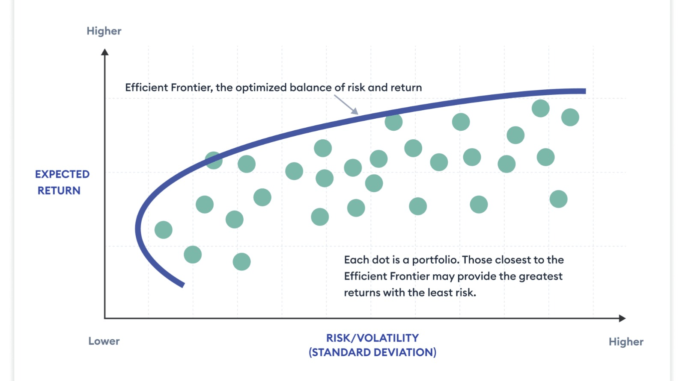
Markowitz Portfolio Optimization Technique
Markowitz Portfolio Optimization Technique attempts to build a portfolio of anti-correlated securities to reduce the risk while trying to achieve a target return. This is also known as a market neutral approach. This technique also introduced the Efficient Frontier, which helps identify the optimal portfolio that can deliver the highest return for a given amount of risk.
Efficient Frontier

Slide 21
03 Evaluation and Results

Slide 22
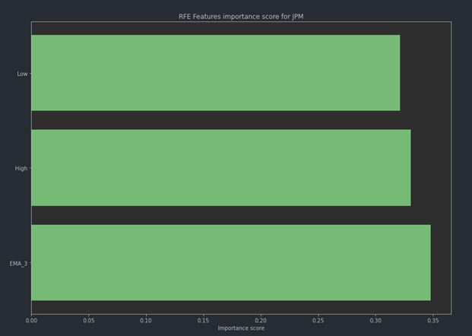
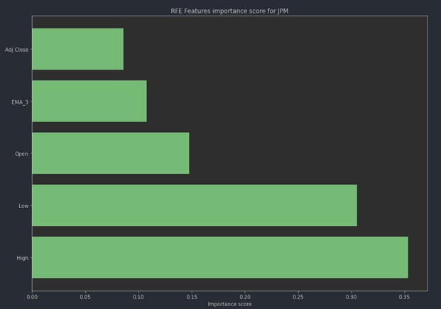
Performing Recursive Feature Elimination (RFE)
JPM stock (Date: Oct 2012 - Mar 2022)
JPM stock (Date: Jan 2015 - Jan 2020)

Slide 23
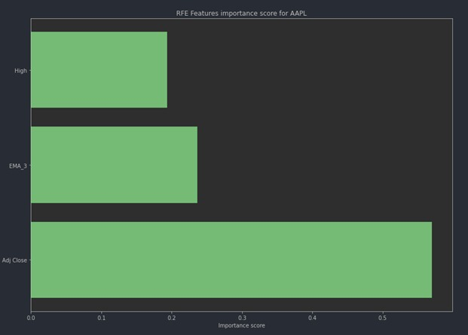
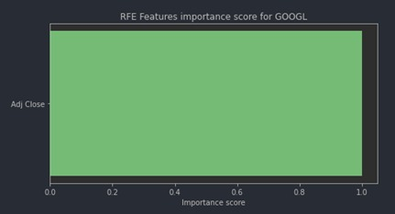
Performing Recursive Feature Elimination (RFE)
AAPL stock (Date: Jan 2012 - Mar 2022)
GOOGL stock (Date: Jan 2012 - Mar 2022)

Slide 24
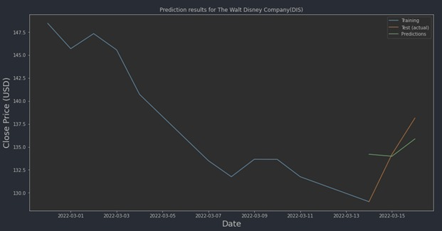
Training LSTM
Date | Actual Close Price | Predicted Close Price
2022-03-14 | 129.03 | 134.1954
2022-03-15 | 134.2 | 133.9843
2022-03-16 | 138.14 | 135.8689
DIS stock (Date: Jan 2012 - Mar 2022)
Prediction results table for DIS data, Mar 2022

Slide 25
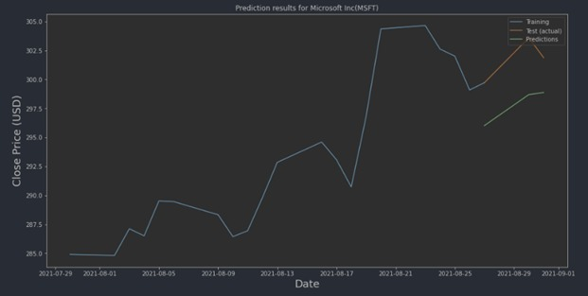
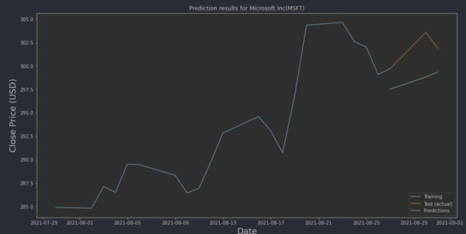
Training LSTM
Prediction results chart for MSFT, Aug 2021
Prediction results chart for MSFT, without RFE, Aug 2021
Date | Close | Predicted
2021-08-27 | 299.72 | 296.0196
2021-08-30 | 303.59 | 298.6906
2021-08-31 | 301.88 | 298.8699
Date | Close | Predicted
2021-08-27 | 299.72 | 297.5196
2021-08-30 | 303.59 | 298.8226
2021-08-31 | 301.88 | 299.3627

Slide 26
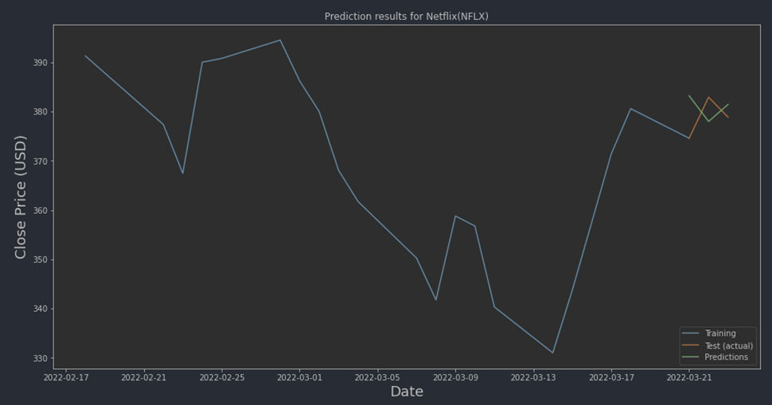
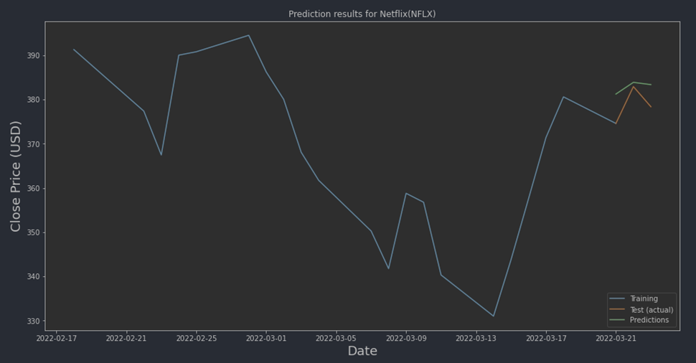
Training LSTM
Prediction results chart for NFLX without
LR reduction , Mar 2022
Prediction results chart for NFLX with
LR reduction , Mar 2022

Slide 27
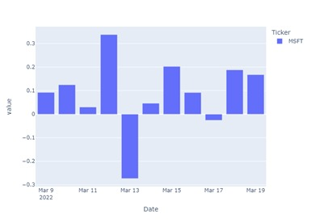
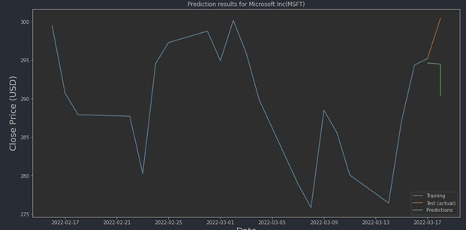
Sentiment Analysis
In times of high volatility, we can incorporate sentiment analysis to predict random bullish or bearish price swings.
Prediction results chart for MSFT, Mar 2022
Sentiment scores for MSFT, Mar 2022

Slide 28
04 Reflection and Future Work

Slide 29
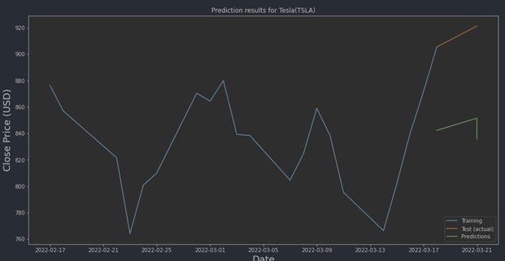
Project Limitations
Incompatible with highly volatile stocks
Inability to comprehend technical indicators
For highly volatile stocks, the LSTM model is unable to deliver satisfactory results. Despite including additional indicators, the LSTM model is unable to predict the closing price for the next 3 days based on historical price data.
The project included several technical indicators which are commonly used by financial experts to understand the price movement of stocks. Unexpectedly, few of these significant technical indicators were not selected during the RFE process. Using these indicators involves complex financial interpretation and therefore the LSTM models were unable to use them effectively.
Prediction results for TSLA, Mar 2022

Slide 30
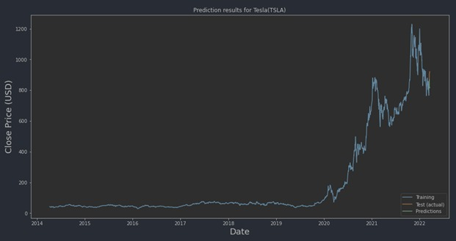
Future Work
During its lifetime, a stock experiences definite changes in behaviour and momentum. The size or time period of the dataset affects the performance of the LSTM model. Providing a relevant and optimally sized dataset can help reduce complexity and allow the LSTM model to focus on the latest trend and behaviour of the stock. This can help incorporate another level of customization wherein for each stock a dataset of optimal size or time period is chosen.
TSLA close prices, 2014 - 2022

Slide 31
05 Conclusion

Slide 32
Conclusion
Customized Learning Environment
Incorporating Sentiment Analysis
By incorporating techniques such as Recursive Feature Elimination (RFE) and Real Time Learning Rate Reduction, the project was able to build a customized learning environment for each stock and recognize each stock’s unique momentum.
By including sentiment analysis, the project was able to capture the random bullish and bearish swings and helped deliver satisfactory results during times of high volatility.
Customized Feature Selection
Real-time learning rate tuning
Incorporating Price Prediction and Sentiment Analysis

Slide 33
THANKS
Do you have any questions?

Slide 34
REFERENCES
Gallardo Del Ángel, R. (2019). Financial time series forecasting using Artificial Neural Networks. Revista Mexicana De Economía y Finanzas, 15(1), 105–122. https://doi.org/10.21919/remef.v15i1.376
Guo, Z., Wang, H., Yang, J., & Miller, D. J. (2015). A stock market forecasting model combining two-directional two-dimensional principal component analysis and Radial Basis Function Neural Network. PLOS ONE, 10(4). https://doi.org/10.1371/journal.pone.0122385
Hochreiter, S., & Schmidhuber, J. (1997). Long short-term memory. Neural Computation, 9(8), 1735–1780. https://doi.org/10.1162/neco.1997.9.8.1735
Ree, S. (2020). The tao of trading: How to build abundant wealth in any market condition. Houndstooth Press.

